Slide 1

Coping with the financial impact of disasters: a micro-perspective
Insurance as a method for Disaster Risk Reduction in SEE
Skopje, 23-24 April 2013
Richard Poulter, Researcher of Disaster Risk Financing
The University of Copenhagen

Slide 2
About me
UK: General Insurance actuary
Denmark: Research focus on use of risk transfer for both governments and individuals to enhance resilience
Specialism in disaster risk financing for low-income countries, particularly in Africa

Slide 3
Contents
The spectrum of risk
Which risks should be insured?
How do individuals cope with disasters?
Who should pay for insurance?
Increasing insurance coverage: benefits
Increasing insurance coverage: demand and supply
Challenges in increasing insurance coverage
The micro perspective – summing up

Slide 4
The spectrum of risk
High
Extreme events
Storms, floods, earthquake etc
Economic cost
Frequent events
Heat wave, short storms, heavy rain etc
Loss frequency distribution
Low
100-year event
Probability
Certain event

Slide 5
Which risks should be insured?
Return period
500 year
Very extreme losses:
Residual risk unprotected as not effective (and too costly) to reduce or transfer risks
Low to medium losses:
Risk reduction more effective
100 year
Medium to extreme losses:
Risk financing more effective
10 year

Slide 6
Example: weather derivative insurance for drought
Probability exceedance curve
Monetary loss
Maximum covered loss = €₂
Minimum covered loss = €₁
€₂
€₁
0%
2%
5%
70%
Monthly Rainfall

Slide 7
Coping with disasters: households and farmers
Most usual financial courses are
  emergency loans from family, micro-credit institutions or money lenders;
  sell or mortgage assets and land;
  or rely on public and international aid.
Limited government assistance
Humanitarian assistance low: in the 1990’s was less than 10% of disaster losses in recipient countries (Freeman et al. 2002).
Notes:
In the absence of government assistance and international aid, poor victims rely on an array of (often innovative) pre- and post-disaster arrangements for financing their recovery.

Slide 8
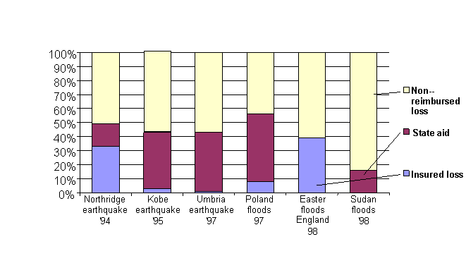
Funding losses
Source: Linnerooth-Bayer and Mechler 2007

Slide 9
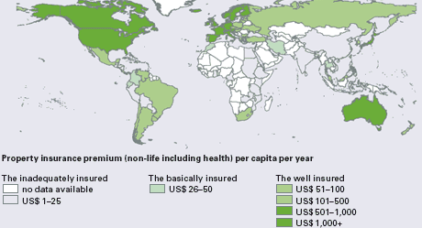
Worldwide insurance coverage
Source: Munich Re Economic Research 2006

Slide 10
Ethical question: who should bear disaster risks?
Efficiency argument: Disaster risks should be responsibility of those who are located in high-risk areas to discourage settlement in these areas and to encourage individual mitigation measures.
Equity argument: There is a need for social solidarity with disaster victims to help poor and those living or working in high-risk areas

Slide 11
Increasing insurance coverage: benefits
A 2012 study by Lloyd’s of London found:
“Underinsurance places an unnecessary burden on the state and results in a higher cost of recovery after disasters.”
A 1% increase in insurance penetration
A 13% reduction in uninsured losses
“Governments can help their economies by opening up markets to private insurers to increase the capacity.”
A 1% increase in insurance penetration
An increased
investment of 2%
of GDP

Slide 12
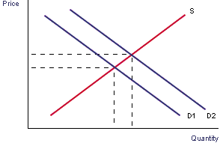
Increasing insurance coverage: demand side
Regulation of insurers to increase confidence in the industry
Premium legislation (max / min / rating factors)
Premium monitoring
Legislation to make insurance compulsory
Providing incentives (or removing disincentives such as generous benefit provision) to take out insurance
Develop bundled products

Slide 13
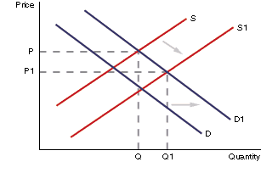
Increasing insurance coverage: supply side
Regulation of insurers to increase confidence in the industry
Legislation to make insurance compulsory
Providing incentives for companies
Catastrophe Insurance Pools (eg Turkey)
Index-Based Agricultural Insurance (eg India)
Agricultural Insurance Pool (eg Mongolia)

Slide 14
A key challenge: risk perceptions
Terrorist attack
Public outrage
Mobile phones
Bird flu
Stock market crash
Plane crash
Daily glass of wine
Heart disease
Credit card
fraud
Cancer
Pedestrian
accident
Heat
Actual hazard
Source: http://www.colorful-data.net/risk-perception-and-actual-hazards/
Notes:
Reality Checking Device (2008) is an interactive machine which offers, on its mirrored surface, statistical information on the current trends of paranoid concern: plane crashes, terrorist attacks, gun crime, bird flu etc.
The work presents a surface where (physical) reflexion, (psychical) reflection, and (statistical) projection converge: the outline of our self-image is one traced by unfounded fears.

Slide 15
Challenges to scaling up insurance coverage
Information and experience
Trust
Connection
Cost/Liquidity
Capacity of insurers to absorb risk
Benefit – insurance isn’t always appropriate!
Notes:
Connection – someone has too many other risks to worry about.

Slide 16
The micro perspective: summing up
Benefits of promoting insurance on a micro level
  Risk financing is most suited to medium to extreme losses
  Individuals have their own coping methods, but the majority of losses are not recovered
  Increasing insurance coverage has big benefits for governments facing natural disaster risks
  Insurance can strengthen a country economically, as well as making it more resilient to disasters
Key challenges
  Individual’s knowledge and experience may not be adequate
  Insurers are often not trusted
  May need state assistance to ensure insurers have capacity

